Slide 1

Our Project: Buzz or Bust
Questionnaire: Data gathering
Case Studies : Neural Network and Randon Forest
Findings and Limitations: how might be used
Repo: https://github.com/jvbonini/WhyExpat_site
Team Members: Lei Qin | Rob Seaberg | Winnie Wu | Joao Victor Bonini

Slide 2


Slide 3
70 Million

Slide 4
www.
.net

Slide 5
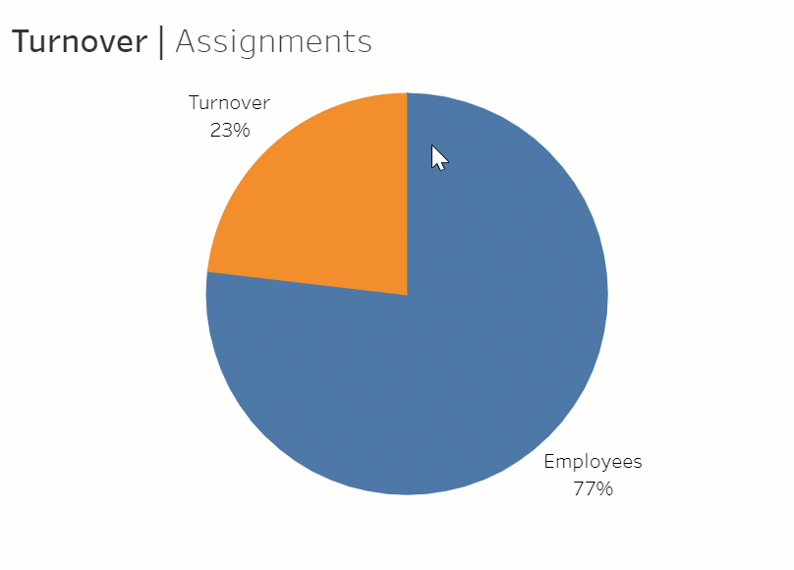

Our Project

Slide 6
Our Project
'satisfaction_level'
'last_evaluation'
'promotion_last_5years'
'average_montly_hours',
'Work_accident'
'number_project'
'salary'
'leader_host'
'culture_host'
'culture_home'
'buzz_bust'
'function_host'
'business Size_host'
'economic Perspective_host'

Slide 7
Questionnaire
Data gathering
To be Included

Slide 8
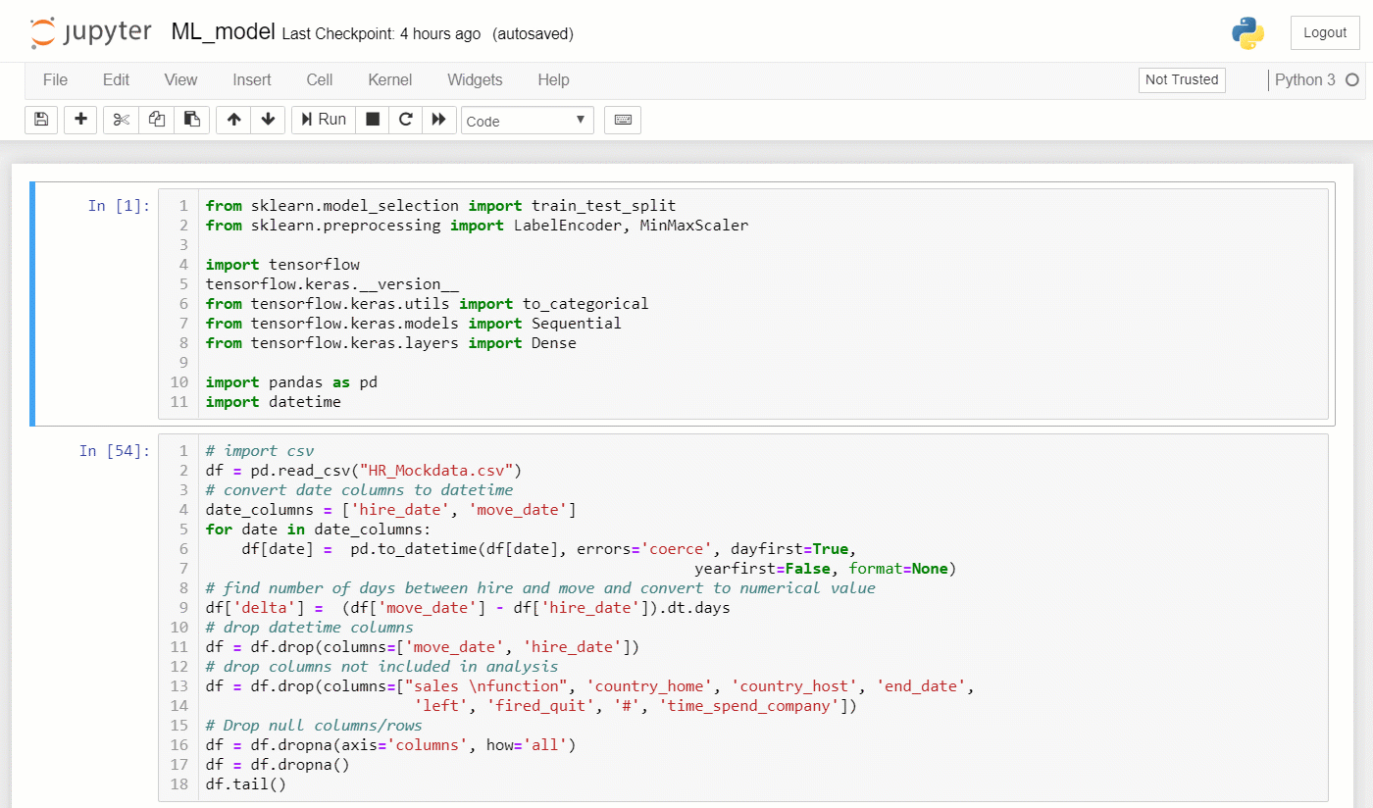
Case Studies
Neural Network
Notes:
45 seg

Slide 9
Case Studies
Random Forest
To be Included

Slide 10
Findings and Limitations
How might be used
To be included

Slide 11
70 Million

Slide 12

...Questions

Slide 13

| End |
Lei Qin | Rob Seaberg | Winnie Wu |Joao Victor Bonini
www.
.net

